Slide 1
Do Now
1. How much are assessments worth?
2. Who makes the midterm and final?
3. What word do the Guidelines for Success spell out? Label the acronym and write down what each letter stands for.
4. What is the expectation concerning homework in regards to notes?
5. What can I do if I miss a class?
6. What do I do if I miss a test?

Slide 2
Khan Academy
Change in the Extra Credit:
  Take 4 diagnostic quizzes in Math
  6 hours of practice per quarter
  Work must be shown for problems
  Turn in by deadline in syllabus

Slide 3
Class website
Options:
Visit: bit.ly/bchsmath OR
Logon to clever.com => Click Mr. Soto’s classroom resources => Click Class webpage icon

Slide 4
Pearson Realize
Go to Clever.com
Login with district credentials (R2.D2, etc.)
Click on Pearson EasyBridge Icon

Slide 5
Khan Academy
Login using the class code:
  Period 1: Y2WRC329
  Period 2: E4Y3XYD7
  Period 7: H669B74B
  Period 8: ANU6BP8J

Slide 6
To Do
Work on the Algebra 2H Skills Review Test on Focus Assignments (show work on piece of paper); you can retake until you get at least 80% on it
If finished, work on Section 1-1 Notes (from the Pearson Realize)

Slide 7
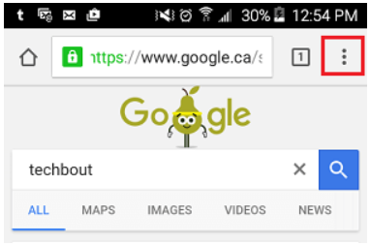
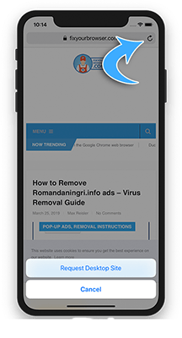
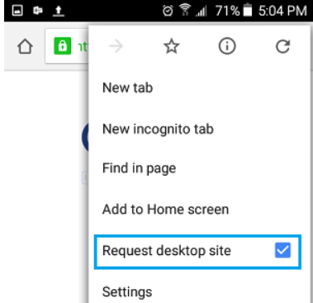
Phone Access to Class Website
Android
Iphones

