Slide 1
Do Now
Work on the #Selfie Poster handout. Finish as much as you can in the next 7 minutes or so.

Slide 2
Circles
Stand up. One by one, share your name, and at least three things about yourself

Slide 3
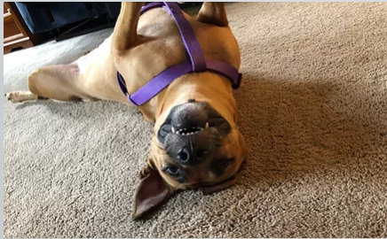
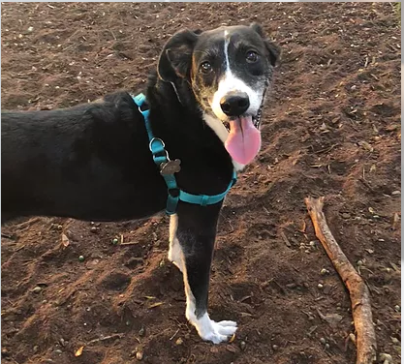
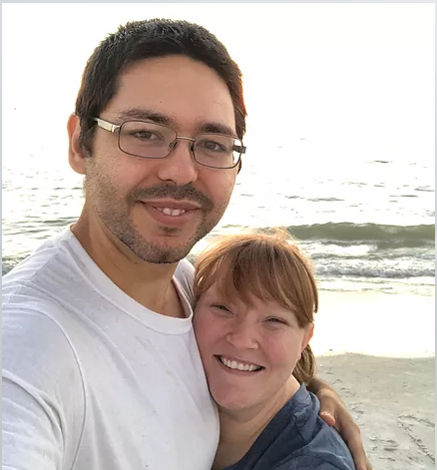
About Me

Slide 4
About Me
Born in Orlando, FL
Latino ethnicity-Puerto Rican
Oldest of two siblings, a brother and a sister.
Brother is working for an electrical company
Sister is in the pharmaceutical/medical field
Hobbies include: working on my car, reading/learning new things, drawing, working on electrical or wood projects, spending time with family on the beach
Attended Florida International University and University of Miami for Biomedical Engineering and Chemistry.
I’ve tutored for 10+ years in physics, chemistry, and mathematics, and wanted to pursue education

Slide 5


Slide 6

Welcome to Algebra 2 Honors
Emmanuel Soto
Boca Ciega High School
Home of the Pirates

Slide 7
The BCHS Bell Schedule
BLUE days are periods 1,3,5, and 7
GOLD days are periods 2,4,6, and 8.
Period 1 or 2: 7:10 to 8:38
Period 3 or 4: 8:45 to 10:15
Lunch: 10:15 to 10:45
Periods 5 or 6: 10:52 to 12:20
Periods 7 or 8: 12:27 to 1:55 (88 min)
Automatic 1 hour detention for all tardies after 1st or 2nd block.

Slide 8

Administration
Traditional Program A - L
Room 4-126
Assistant Principal: Mr. Lane
Guidance Counselor: Ms. Banks
Office Assistant: Ms. Sanchez
MTSS: Ms. Turner

Slide 9

Administration
Traditional Program M - Z
Room 4-326
Assistant Principal: Dr. Craun
Guidance Counselor: Ms. Reiss
Office Assistant: Ms. Gibbons
MTSS: Coach Shuman

Slide 10


Administration
Assistant Principal CWMP: Ms. Fabrizio
CWMP Office
Guidance Counselor: Ms. Love
Office Assistant: Ms. Simmons
Assistant Principal Fundamental Program: Ms. Van Dora
Room 1-038
Guidance Counselor: Ms. Woods
Office Assistant: Mrs. Mogil

Slide 11

The Dress Code
The Nine B’s
No Bellies
No Bandanas or head coverings
No Backs
No Boxers
No Butts
No Bedroom slippers
No Bras
No Bad Logos
No Bare Arms

Slide 12
The Pirate Pact
PREPARED for high school and life
INCLUSIVE, working together as The BCHS community
RESPECTFUL, of self, others, & learning the community
ATTITUDE, fostering positive relationships
TENACIOUS, never give up
EMPOWERED, being responsible for our learning
On back of paper of Do Now, describe how the guidelines for success look like in the classroom?

Slide 13
Guidelines for Success | Classroom Rules
Prepared for high school and life | 1. Treat others the way you would like to be treated 2. Avoid using profanity, abusive language, and put downs 3. Keep hands, feet, and objects to yourself 4. Take good care of school property 5. Be in your assigned seat prior to the bell 6. Arrive prepared to class with binder, pencil, and notebook 7. Follow directions the first time given 8. Refrain from sleeping in class and putting your head down 9. Refrain from eating and drinking in class (except water) 10. Silence and put away all electronic devices until directed otherwise 11. Remain in your seat at the end of the period 12. Use an appropriate voice level at all times
Inclusive, working together as the BCHS community
Respectful of self, others, and the learning community
Attitude and appropriateness, fostering positive relationships
Tenacious, never give up
Empowered and engaged, being responsible for our learning

Slide 14
On the back of your Do Now, answer the question: which rule numbers correspond to which Pirate guidelines? Discuss with your group. i.e: P: 1, 8
I: 3, 5

Slide 15
Algebra 2
From Mathplanet:
Algebra 2 is the third math course in high school and will guide you through among other things linear equations, inequalities, graphs, matrices, polynomials and radical expressions, quadratic equations, functions, exponential and logarithmic expressions, sequences and series, probability and trigonometry.

Slide 16
Grade Highlights
Binder Checks (15%)
Classwork/Homework (40%)
Assessments (45%) –Tests and quizzes
Extra Credit (2 options totaling 10%)

Slide 17
Binder Checks
You must use a binder for this grade (no folders, notebooks, etc.)
Three tabs: Do Nows, Notes, and Classwork/Homework
Bring it daily to get credit for assignments that are checked during class (assignments in the binder)
If you did not bring binder at the time of an assignment check, you will get points deducted off the assignment.

Slide 18
Classwork/Homework
Classwork involves practice problems from the student workbook, group activities, etc.
Work will usually be checked during class unless otherwise instructed, but it must be in the binder at the time of the check.
Work must be shown for all problems (classwork or homework) to get full credit
Homework-2 Kinds
  Online weekly assignments on Pearson Realize due Sunday night 11:59 pm. Work must be shown on piece of paper and turned in the class following this due date.
  Note handouts filled out and completed for the lesson prior to the class in which lesson will be presented.

Slide 19
Classwork/Homework
If you miss class, you will have 1 school day for each day you are absent to turn in work from deadline (if you miss a class on Monday and assignment is due Wednesday, then the new due date is the class after)
If absent, write “Absent” on paper, and turn in absent bin or ask me to check it (if it was checked during class and not turned in)

Slide 20
Assessments
You are responsible for info missed during absences
If you miss a quiz or test, you will have to make up the assessment after school within a week unless there are extenuating circumstances. Let me know what day you will make up the assessment.
Prompt: What does it mean to be academically honest? What are some examples? Why is it important to be academically honest? Discuss with your group

Slide 21
Final Exams
There is no longer a district-created midterm and final for Algebra 2!
It will be created and agreed to by Algebra 2 teachers in the school
You can exempt the midterm OR the final if you have the necessary grade requirements and attendance (grade must be high enough before extra credit for it to be approved).
Maintain your grade and attendance status if approved for exemption for the duration of the semester.

Slide 22
Do Now (P1)
Turn in 2 handouts (get to know you, #selfie portrait) from last class into Period 1 plastic bin
Tear off last page of syllabus and turn into Period 1 plastic bin(must be signed and survey must be filled)
Get a sheet of paper and pencil out

Slide 23
Extra Credit
Two main opportunities for extra credit:
  Work on Khan Academy SAT Math Prep to earn a max of 5% extra credit (on top of final grade).
    Do Quizzes 1-4 on Math SAT practice
    Work at least 6 hours SAT Math practice skills per quarter
    Quarter 1: Due October 4th 11:59 pm
  Turn in cell phone at the beginning of every class to get up to 5% extra credit (on top of final grade).
    i.e: If there are 21 days in Quarter 1, and you did not turn in your phone on 3 of those days, you get 18/21 *5% or 4.3% extra credit for that Quarter. I usually round this number.

Slide 24
What are some of the processes or steps you will take to be successful? Write down a few things.

Slide 25

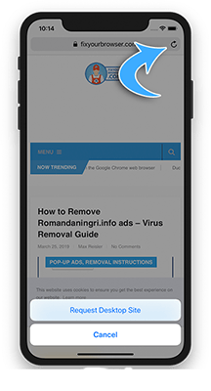
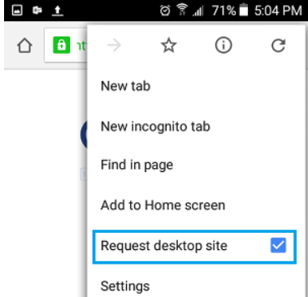
Phone Access to Class Website
Android
Iphones

Slide 26

Online Resources
Class website: bit.ly/bchsmath
Pearson website:
-Go to Clever.com
-Login with R2.D2, etc.
-Click on Pearson EasyBridge
-Select your textbook

Slide 27
Assignment given time
-Work on class 1.1 notes by navigating website on
Phone
-Finish syllabus survey (front and back page of last paper)
HW: Signed Syllabus and Survey

